Slide 1
Distributed Multicast Client-Server Model SP15-01 Team
Problem Statement :
To divide a task across multiple processes/processors on different nodes/same node and then collate the results.
Team :
Ravindra Kumar
Sanmugavadivu
Shashank Gupta
Sameer Tandon

Slide 2
Content
Problem Statement
Design Overview
Implementation Details
Infras Used
Few data structures
Testing data
Demo
Github repo link

Slide 3
Problem Statement
Emulate a parallel computing environment
Simple server and client program using IPC/Sockets
Clients join a group on server.
A parallel program (eg:-max of given large set of numbers), will be executed on server. Server will distribute the task into smaller subsets and send it across to clients for execution and then server will collate the results and display the output.
A job client submits tasks to server.

Slide 4
DesignOverview
Need a single threaded with non-blocking I/O. Can’t go with multithreaded as it poses scaling challenges.
epoll_server (TCP/UDP server) Why ?
select() : FD_SETSIZE -> hardcoded limit, can’t go beyond it.
poll() : no hardcoded limit, but loops through all open fds, to check if there is any data, slow.
epoll() : event-based,
Compute clients
job clients

Slide 5
Server
Epoll based server
Handles clients’ requests to join to or exit from a group.
Accepts job submitted by job clients
Distributes it across compute_clients, collates the results and send it to the requester.
Error scenarios handling

Slide 6
Compute Client
Epoll based client
Join a group on server, exit from a group
Computes data received from server & replies as soon as done
Multiple compute clients connected simultaneously
Computation Tasks :
Max
Min
Max Prime number

Slide 7
Job Client
Epoll job client
Connect to server
Prompt user for job filename
Read job_file & send data to server
Send multiple jobs simultaneously & display result as soon as available

Slide 8
Implementation-Server
main thread – monitor all connected fd(s) & push to job_queue
Main thread – spawns the worker threads
Four worker threads – Pop data from queue & process
Worker threads - Calls event_handler
Mutex lock required for accessing data in job_queue
Conditional variable - Main thread broadcasts whenever it pushes data in job_queue
set_rlimit() – used to increases no. of open fds, system limit of server.
Server : bind() and listen(); accept() on event
Client : connect()

Slide 9
Implementation-Server
Conditional var : typically used in producer-consumer. Producer wakes up consumer whenever it puts something into queue. Consumer doesn’t every time need to take mutex on queue and check if it only to find that q is empty. (polling)
A mutex only allows you to wait until the lock is available; a condition variable allows you to wait until some application-defined condition has changed.
IMP : Copy the job from queue to a local structure, and then release the lock before going ahead to process struct otherwise not much parallelism is achieved.

Slide 10
Implementation-Server (Epoll)
Wait infinitely on epoll server; epoll_wait()
It returns in case of event. If new connection, returns socket_fd of server on which it is listening. Thus, we know that a new connecn & we add it epoll to monitor
If returns a i/p sock_fd, we read the data from buffer using read(). We come to know the event msg.
Convert json to msg_struct. Acquire mutex. Push data to q. Broadcast to cond var.

Slide 11
Data Structures
/*Generic Messsage Structure for communication b/w client & server*/
typedef struct
{
Events event;
Result result;
int client_id;
int data_len;
int *data;
}Message;
^{/*Currently supported events*/}
^{typedef enum events}
{
//CCLIENT = compute client, JCLIENT = job client
SERVER_CCLIENT_GROUP_IDS_SUPPORTED =0,
SERVER_CCLIENT_CONNECTION_ACCEPTED =1,
SERVER_CCLIENT_DATA_TO_COMPUTE =2,
SERVER_JCLIENT_FINAL_COMPUTE_RESULT =3,
CCLIENT_SERVER_GROUP_ID_TO_JOIN =4,
CCLIENT_SERVER_GROUP_ID_EXIT =5,
CCLIENT_SERVER_COMPUTE_RESULT =6,
JCLIENT_SERVER_COMPUTE_MY_DATA =7,
^{JCLIENT_SERVER_JOIN,}
^{}Events;}

Slide 12
Implementation- Compute Client
Main thread – Monitors fd(s) & push data into job_queue
2 worker threads to process data

Slide 13
Implementation- Job Client
Main thread : monitor fd for results of submitted jobs
Worker thread : prompt user for job_file.
Send job to server whenever available
Submit multiple jobs simultaneously and display results

Slide 14
Infras/Features
Jansson :
For packing and parsing of messages sent between server and clients
parseStruct – parses the message structure to form string to be sent; json_object_set(); json_integer(msg->event);
parseJson - parses the Json string and forms the struct Message; json_integer_value() : extract int field from string
Open_grok setup for code browsing
Debugging infra

Slide 15
Debugging Infra
Debug and Error handling Infra :
- Provides various debugging facilities , syslog generation , debug mode , different levels to log the messages.
- Handles connection termination of a client , timeout for a submitted task , handling group exit request from client while performing a task , etc
- ./server 2000 –to_sys_log : will create server. <timestamp>_syslog file
- log messages can be printed at any level.., INFO , WARNING , ERROR , FATAL, DEBUG.

Slide 16
Syslog file output
SVADIVU-M-D05Q:cohort-15 svadivu$ cat server. _Mon Dec 5 21:06:49 2016?_syslog Mon Dec 5 21:06:49 2016: INFO::Initilizing Server.. Mon Dec 5 21:06:49 2016: INFO::Current rlim_cur = 1024 and rlim.rlim_max =4096 setrlimit : Failed to changes the number of supported FDs due to permisions, Try from root Mon Dec 5 21:06:49 2016: INFO::Group structure init done! Mon Dec 5 21:06:50 2016: INFO::Server socket[3] created and binded successfully Mon Dec 5 21:06:50 2016: INFO::socket 3 set as non Blocking Mon Dec 5 21:06:50 2016: INFO::epoll_create done efd=4 Mon Dec 5 21:06:50 2016: INFO::Server initialized!! Waiting for client connections . . Mon Dec 5 21:06:51 2016: INFO::Worker thread [0] initialized!! Mon Dec 5 21:06:51 2016: INFO::Worker thread [2] initialized!! Mon Dec 5 21:06:52 2016: INFO::Worker thread [1] initialized!! Mon Dec 5 21:06:52 2016: INFO::*********** On epoll_wait **********

Slide 17
Test Results
Shell scripts used
Can scale up to 1k group
Tested it with 10k clients spanning across the groups (epoll should scale as much as to supported fd)
Send 10k integers for computations amongst 3 clients

Slide 18
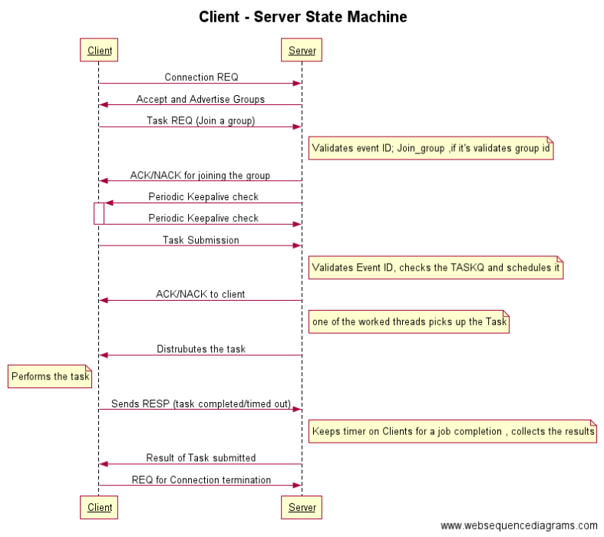

Slide 19
DEMO

Slide 20
SERVER
*********** On epoll_wait **********
Group[0]:: 6 7 no.of_clients = 2
Group[1]:: no.of_clients = 0
Group[2]:: no.of_clients = 0
Group[3]:: no.of_clients = 0
Group[4]:: no.of_clients = 0
Group[5]:: no.of_clients = 0
Group[6]:: no.of_clients = 0
Group[7]:: no.of_clients = 0
Group[8]:: no.of_clients = 0
Group[9]:: no.of_clients = 0
Group[10]:: no.of_clients = 0
Group[11]:: no.of_clients = 0
Group[12]:: no.of_clients = 0
Group[13]:: no.of_clients = 0
Group[14]:: no.of_clients = 0
Group[15]:: no.of_clients = 0
Group[16]:: no.of_clients = 0
Group[17]:: no.of_clients = 0
Group[18]:: no.of_clients = 0
Group[19]:: no.of_clients = 0
Server: Total number of clients active at the moment = 2
Server started and 2 clients are joined to the first group

Slide 21
JOB_CLIENT
[shashank@server1 SP15]$ ./job_client 127.0.0.1 8000
connecting to 127.0.0.1
Main thread : Rcvd data from fd = 3 :: {"client_id": 5, "result": 1, "event": 0, "data_len": 20, "data": [0, 1, 2, 3, 4, 5, 6, 7, 8, 9, 10, 11, 12, 13, 14, 15, 16, 17, 18, 19]}
Enter job file name : job_file
Job client started and 100 random integers read from a file and sent to server

Slide 22
SERVER
MESSAGE RECEIVED :
msg.event = 7
msg.result = 1
msg.client_id = 5
msg.data_len = 100
msg->data =
6784 2819 5813 4432 7492 8667 571 8970 6465 2731 5789 8477 156 3438 8251 3573 4570 8048 8146 1883 6153 1014 8442 6059 9014 600 5615 5752 8331 5506 9849 1467 8325 2014 5899 2169 7033 6470 1139 3498 9202 3280 1976 9358 3070 6579 2931 7641 979 7429 5876 7132 4796 4318 9543 3810 1270 1510 9562 9601 3368 5764 7421 8045 7778 3320 214 1164 9791 7705 4662 5345 985 2990 4703 4056 9569 3986 8049 549 1415 3925 4033 6211 4595 9929 6374 2217 7791 2288 8171 1160 8052 5592 9205 2183 8912 5772 3347 5055
Server receives the data and sends to clients

Slide 23
COMPUTE CLIENT_1
[shashank@server1 SP15]$ ./client 127.0.0.1 8000
connecting to 127.0.0.1
Main thread : Rcvd data from fd = 3 :: {"client_id": 6, "result": 1, "event": 0, "data_len": 20, "data": [0, 1, 2, 3, 4, 5, 6, 7, 8, 9, 10, 11, 12, 13, 14, 15, 16, 17, 18, 19]}
Worker thread [1] initialized!!
Worker thread [0] initialized!!
Main thread : Rcvd data from fd = 3 :: {"client_id": 6, "result": 1, "event": 2, "data_len": 50, "data": [6784, 2819, 5813, 4432, 7492, 8667, 571, 8970, 6465, 2731, 5789, 8477, 156, 3438, 8251, 3573, 4570, 8048, 8146, 1883, 6153, 1014, 8442, 6059, 9014, 600, 5615, 5752, 8331, 5506, 9849, 1467, 8325, 2014, 5899, 2169, 7033, 6470, 1139, 3498, 9202, 3280, 1976, 9358, 3070, 6579, 2931, 7641, 979, 7429]}
maximum value found = 9849
Compute_client receives half the data, finds the maximum and sends back to server

Slide 24
COMPUTE CLIENT_2
[shashank@server1 SP15]$ ./client 127.0.0.1 8000
connecting to 127.0.0.1
Main thread : Rcvd data from fd = 3 :: {"client_id": 7, "result": 1, "event": 0, "data_len": 20, "data": [0, 1, 2, 3, 4, 5, 6, 7, 8, 9, 10, 11, 12, 13, 14, 15, 16, 17, 18, 19]}
Worker thread [1] initialized!!
Worker thread [0] initialized!!
Main thread : Rcvd data from fd = 3 :: {"client_id": 7, "result": 1, "event": 2, "data_len": 50, "data": [5876, 7132, 4796, 4318, 9543, 3810, 1270, 1510, 9562, 9601, 3368, 5764, 7421, 8045, 7778, 3320, 214, 1164, 9791, 7705, 4662, 5345, 985, 2990, 4703, 4056, 9569, 3986, 8049, 549, 1415, 3925, 4033, 6211, 4595, 9929, 6374, 2217, 7791, 2288, 8171, 1160, 8052, 5592, 9205, 2183, 8912, 5772, 3347, 5055]}
maximum value found = 9929
Compute_client 2 receives the other half of data, finds the maximum and sends back to server

Slide 25
SERVER
MESSAGE RECEIVED :
msg.event = 6
msg.result = 1
msg.client_id = 6
msg.data_len = 2
msg->data =
0 9849
MESSAGE RECEIVED :
msg.event = 6
msg.result = 1
msg.client_id = 7
msg.data_len = 2
msg->data =
0 9929
Server waits for the results to come from all clients.
Then sends back the data to compute_client 1 for final max

Slide 26
COMPUTE_CLIENT 1
Main thread : Rcvd data from fd = 3 :: {"client_id": 6, "result": 1, "event": 2, "data_len": 2, "data": [9849, 9929]}
maximum value found = 9929
Compute client 1 receives the data , and sends back the final outcome to server

Slide 27
SERVER
Server: Total number of clients active at the moment = 2
MESSAGE RECEIVED :
msg.event = 6
msg.result = 1
msg.client_id = 6
msg.data_len = 2
msg->data =
0 9929
*********** On epoll_wait **********
Computation over. Sending data to job_client
Server receives the final value and sends it back to the Job client.

Slide 28
JOB_CLIENT
Main thread : Rcvd data from fd = 3 :: {"client_id": 5, "result": 1, "event": 3, "data_len": 1, "data": [9929]}
Final result = 9929
Job client receives the final result

Slide 29
GITHUB REPO LINK
https://github.com/shankyrox/SP15.git

